Slide 1
AN ANALYSIS OF CONSUMER PURCHASING BEHAVIOR
Presented by – Daniel Okunade

Slide 2
INTRODUCTION
What do mainstream customers and ‘Old’ brand have in common? They’re both dominating the chip market!
In this presentation, I will be talking about customer’s purchasing habits, store patronage, brand preference, and more. My goal is to provide you with valuable insights to improve your marketing strategy which will in turn boost sales and increase your customer satisfaction and to recommend whether or not the trial layout should be rolled out to all their stores.

Slide 3
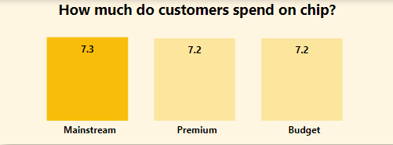
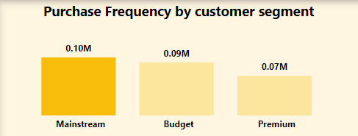
Mainstream Customers
The most valuable segment for chip sales is mainstream consumers. This is because they spend more money and buy more chips than any other customer segment.

Slide 4
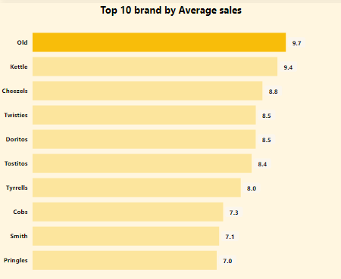
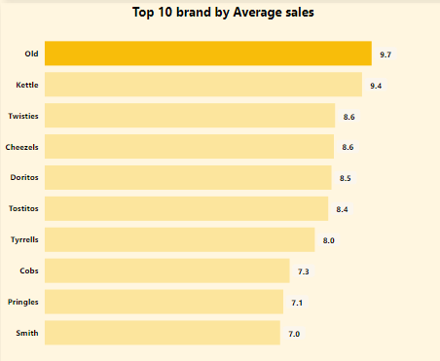
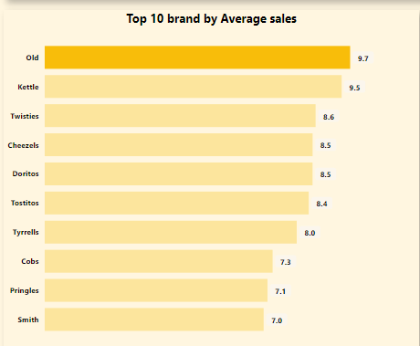
Brand
All the customer segments spends more on the "Old" brand than any other brand.
Mainstream Customers
Premium Customers
Budget Customers

Slide 5
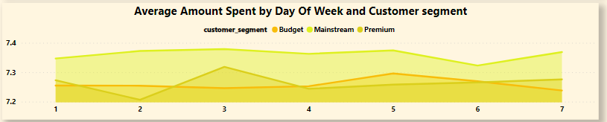
Spending Patterns
Mainstream customers consistently spend more on chips than any other segment throughout the week. Budget customers spend more than premium customers except for Monday, Wednesday, and Sunday.

Slide 6
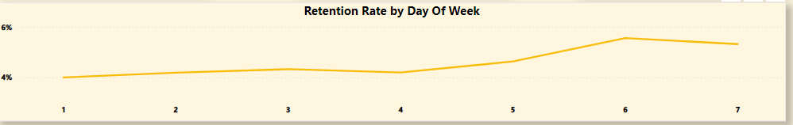
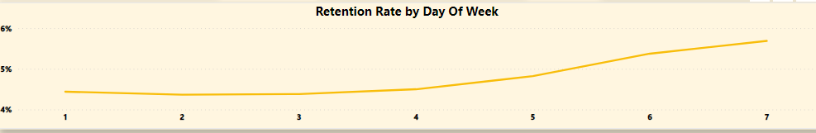
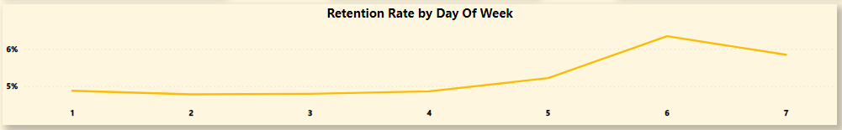
Customer Retention
Mainstream customers
Customer retention rates are higher on weekends than weekdays for all customer segments.
Premium customers
Budget customers

Slide 7
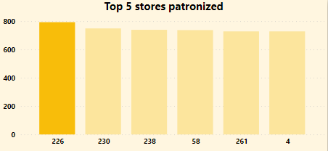
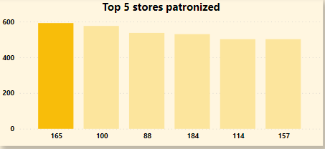
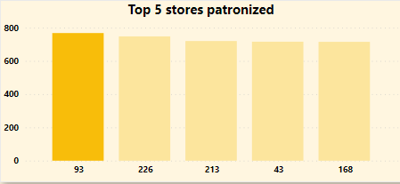
Store Preference
Store 226 is the most popular for Mainstream customers, Store 165 for premium customers, and Store 93 for Budget customers.
Mainstream Customers
Premium Customers
Budget Customers

Slide 8
Trial Vs Control Stores
With a p-value of 0.000, Trial stores 77 and 88 performed significantly differently in terms of sales compared to their respective control stores 64 and 162 , suggesting that the new layout is effective at increasing sales. However, there isn’t enough evidence to conclude that trial stores 86 performed significantly differently compared to its control store 122.

Slide 9
Drivers of sales and Metrics to Track
Based on the result of the regression analysis model, average transaction per customer, total transaction, product quantity and total no of customers are major influencers of changes in overall sales in the trial and control stores. However, Total Transaction per customer was identified to have the most favorable impact on overall sales in store 77 and 86. Total number of customers was seen to be major driving force for sales in store 64, while Product quantity was the major driver of sales in store 162. It's crucial to keep in mind that these findings only demonstrate correlation and do not imply causation.

Slide 10
Recommendations
Based on the findings and insights generated, the following are recommended:
Targeted advertisements and promotions should be conducted to reach more Mainstream customers since they spend more and purchase more frequently than any other segment.
Average revenue across all customer segments is higher for the "Old" brand. This brand's strength can be leveraged during marketing campaigns to boost sales.
Customer retention rates are higher on weekends than weekdays for all customer segments, hence, special promotions or discounts should be offered on weekends to take advantage of this trend.
Marketing efforts should be customized for specific stores that is popular among different customer segments to increase sales. For example, Store 226 is the most popular for Mainstream customers, Store 165 for premium customers, and Store 93 for Budget customers.
The results of the experiment show that the trial stores 77 and 88 had significantly higher sales than their respective control stores. This is likely due to the new layout, which was designed to increase customer flow and impulse purchases. Hence, it is recommended that the trial layout should be implemented.

